Slide 1


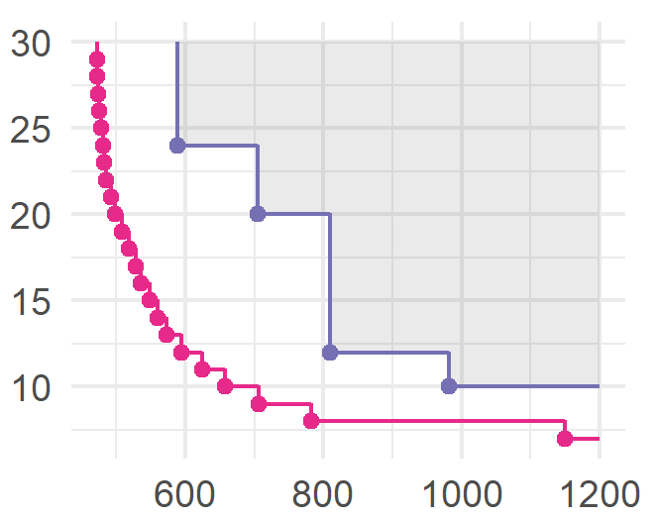
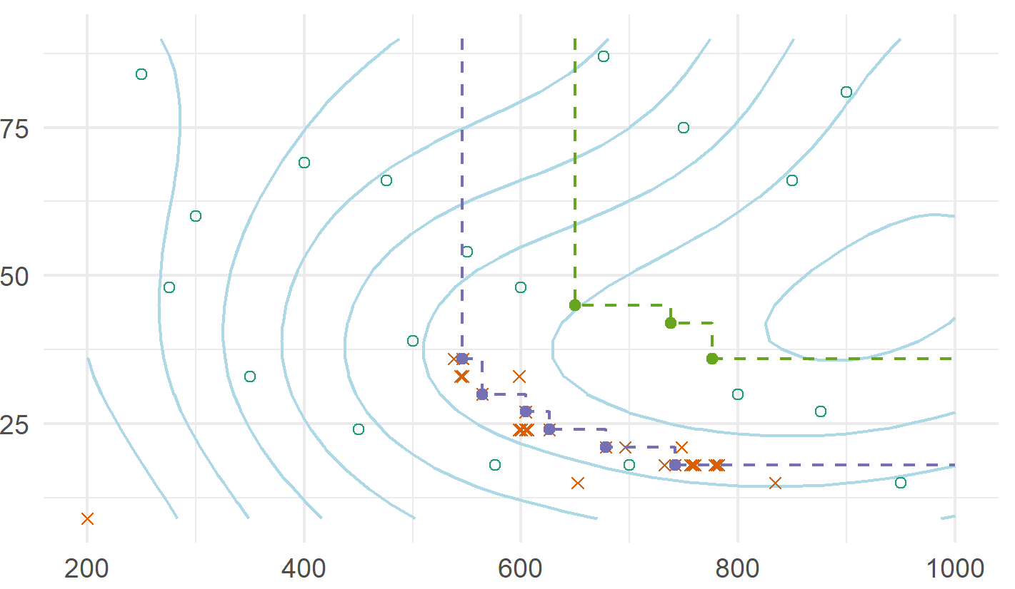

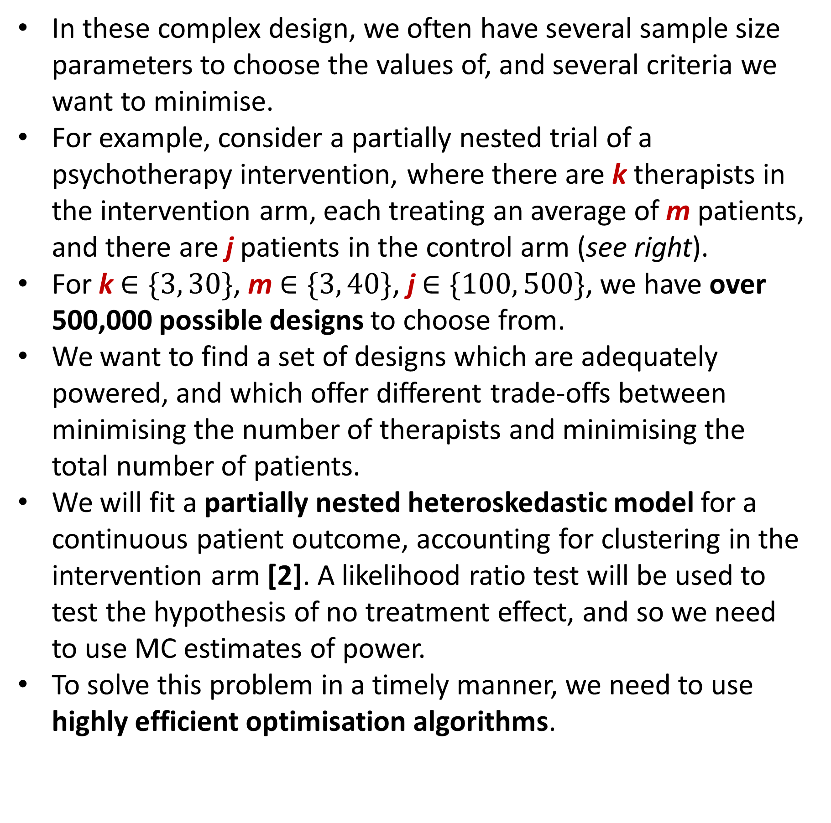
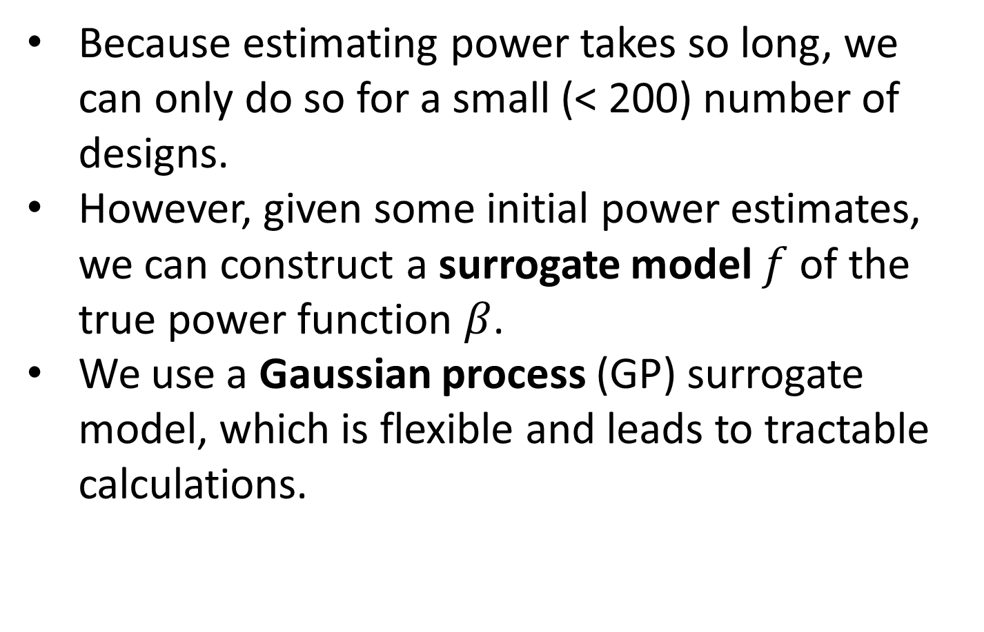
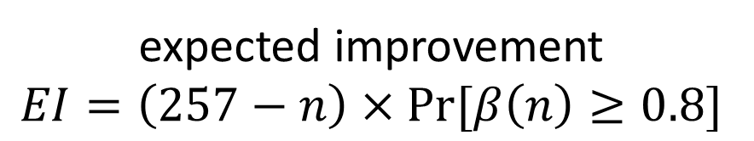
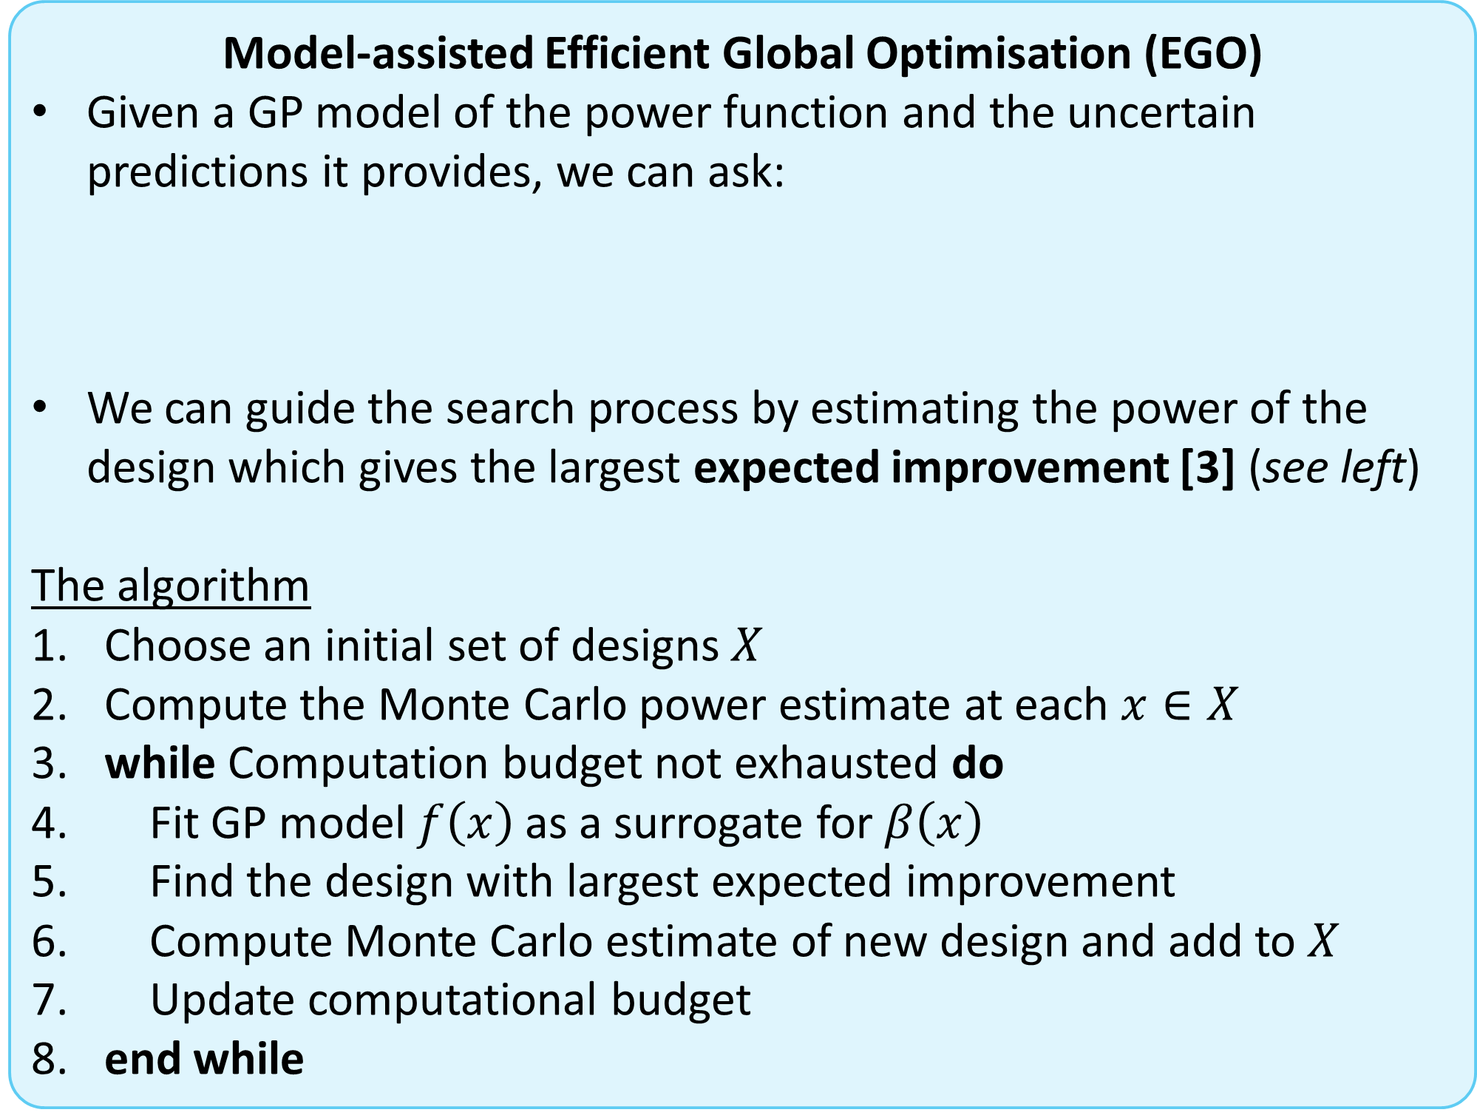
Efficient and flexible simulation-based sample size determination for clinical trials with multiple design parameters
Duncan T. Wilson^{a,*}, Rebecca E. A. Walwynª, Richard Hooper^{b}, Julia Brownª, Amanda J. Farrinª
a - Clinical Trials Research Unit, Leeds Institute of Clinical Trials Research, University of Leeds
b – Pragmatic Clinical Trials Unit, Blizard Institute, Queen Mary University of London
* - D.T.Wilson@leeds.ac.uk; @DTWilson; github.com/DTWilson
Background
For complex trial designs and analyses, simple analytic formulae for power calculations are not always available.
In such cases we can always fall back on Monte Carlo estimates of power, and use these when determining the optimal sample size [1].
This can be computationally demanding, requiring a considerable number of MC samples, N, to deliver a precise power estimate (see below).
In these complex design, we often have several sample size parameters to choose the values of, and several criteria we want to minimise.
For example, consider a partially nested trial of a psychotherapy intervention, where there are k therapists in the intervention arm, each treating an average of m patients, and there are j patients in the control arm (see right).
For k $∈\{3, 30\}$, m $∈\{3, 40\}$, j $∈\{100, 500\}$, we have over 500,000 possible designs to choose from.
We want to find a set of designs which are adequately powered, and which offer different trade-offs between minimising the number of therapists and minimising the total number of patients.
We will fit a partially nested heteroskedastic model for a continuous patient outcome, accounting for clustering in the intervention arm [2]. A likelihood ratio test will be used to test the hypothesis of no treatment effect, and so we need to use MC estimates of power.
To solve this problem in a timely manner, we need to use highly efficient optimisation algorithms.
Therapy
Treatment as usual
1.1
1
. . .
1
1.m
2
. . .
. . .
therapists
Estimated power
k.1
k
. . .
j
k.m
Methods
Log(N)
patients
Because estimating power takes so long, we can only do so for a small (< 200) number of designs.
However, given some initial power estimates, we can construct a surrogate model $f$ of the true power function $β$.
We use a Gaussian process (GP) surrogate model, which is flexible and leads to tractable calculations.
A GP model represents our belief about the power of a design through a normal distribution, giving both a point prediction (the mean) and a measure of the uncertainty in that prediction (see below).
GP models are commonly used in a wide variety of fields, and several R packages for fitting GPs are available.
Multi-objective optimisation
Want to find several designs with nominal power and different trade-offs.
Optimisation aims for the Pareto set…
…but may only find an approximation set.
Approximation
Providers
Pareto
Predicted power at
n = 183
evaluated designs
patients
GP uncertainty
Model-assisted Efficient Global Optimisation (EGO)
Given a GP model of the power function and the uncertain predictions it provides, we can ask:
We can guide the search process by estimating the power of the design which gives the largest expected improvement [3] (see left)
The algorithm
Choose an initial set of designs $X$
Compute the Monte Carlo power estimate at each $x∈X$
while Computation budget not exhausted do
Fit GP model $f\left(x\right)$ as a surrogate for $β\left(x\right)$
Find the design with largest expected improvement
Compute Monte Carlo estimate of new design and add to $X$
Update computational budget
end while
best current design, n = 257
Compared with the best design I have found so far, what improvement can I expect to see if I estimate the power of this new design?
power
GP mean
function
expected improvement
$$EI=\left(257−n\right)×Pr⁡[β\left(n\right)≥0.8]$$
Illustration
sample size n
We applied EGO the above partially nested psychotherapy example. For comparison, we also used a simple space-filling experimental design.
50 designs were evaluated, using N=100 Monte Carlo samples each time.
We found that EGO can quickly locate efficient, powered designs.
Using the same computational budget, the space-filling design approach found fewer designs, with considerably larger sample size requirements.
Initial designs evaluated
Best solutions found using the space filling design
2n | k | j | Power (s.e.)
742 | 6 | 12 | 0.093 (0.003)
678 | 7 | 14 | 0.081 (0.003)
626 | 8 | 16 | 0.087 (0.003)
604 | 9 | 18 | 0.077 (0.003)
564 | 10 | 20 | 0.081 (0.003)
546 | 12 | 24 | 0.084 (0.003)
Providers (k +j)
Designs evaluated during the search
Contours of the GP predicted power function
Best solutions found using the EGO method
References
Patients (2n)
[1] Landau, S. & Stahl, D. (2013), Sample size and power calculations for medical studies by simulation when closed form expressions are not available, Statistical Methods in Medical Research, 22, 324-345. [2] Roberts, C. & Roberts, S. A. (2005), Design and analysis of clinical trials with clustering effects due to treatment, Clinical Trials, 2, 152-162. [3] Jones, D. R. (2001), A Taxonomy of Global Optimization Methods Based on Response Surfaces, Journal of Global Optimization, 21, 345-383.
Acknowledgements
Duncan Wilson is funded by an MRC Skills Development Fellowship

